Slide 1
Homework #1 due Friday, Sept. 2, 5:00 pm.
PDF version in FILES/HOMEWORK folder
Answers submitted using Canvas Quizzes tool

Slide 2

Monday, Sept. 12
Swain West 007
7:00 pm (153 minutes)
Winner of several awards
BYOP
(Bring Your Own Popcorn)
Notes:
Pandora – moon of gaint planet Polyphemus in alpha Cen system

Slide 3
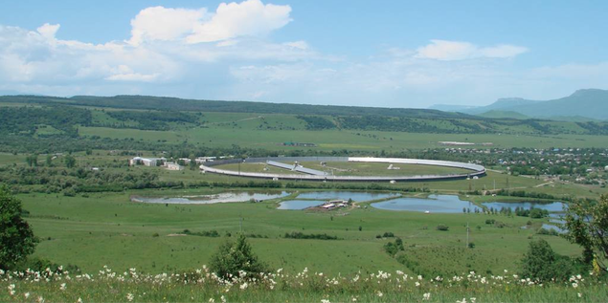
Yesterday, it was announced that in May 2015 a Russian radio telescope spotted a strong radio signal coming from the vicinity of the sunlike star HD 164595 (94 light-years from Earth)
The signal conceivably fits the profile of an intentional transmission from an extraterrestrial source”
Notes:
39 observations, one detection. Will discuss the signal next month at the 67th International Astronautical Congress (IAC) in Guadalajara, Mexico.

Slide 4
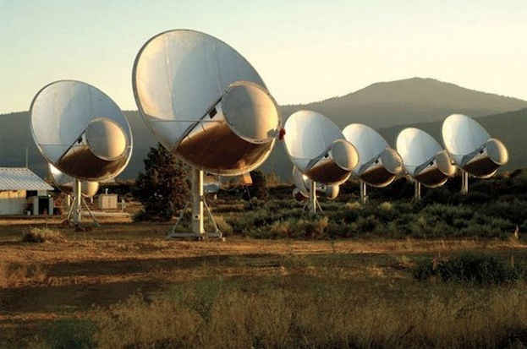
The signal is provocative enough that the researchers are calling for permanent monitoring of this target
Notes:
39 observations, one detection. Will discuss the signal next month at the 67th International Astronautical Congress (IAC) in Guadalajara, Mexico.

Slide 5
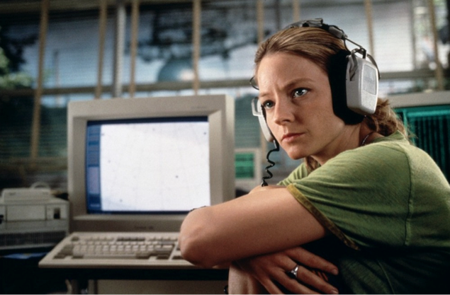
HOWEVER, The signal may have resulted from a natural celestial event or terrestrial interference of some sort.
Notes:
39 observations, one detection. Will discuss the signal next month at the 67th International Astronautical Congress (IAC) in Guadalajara, Mexico.

Slide 6
The origins of astronomy and the physical sciences stem from:
observing repeatable patterns in the sky and in nature – “observed facts”
developing a model to explain these patterns
testing the model

Slide 7
Celestial Sphere
And Local Sky
On a daily basis, stars appear to move around the sky in a regular manner

Slide 8
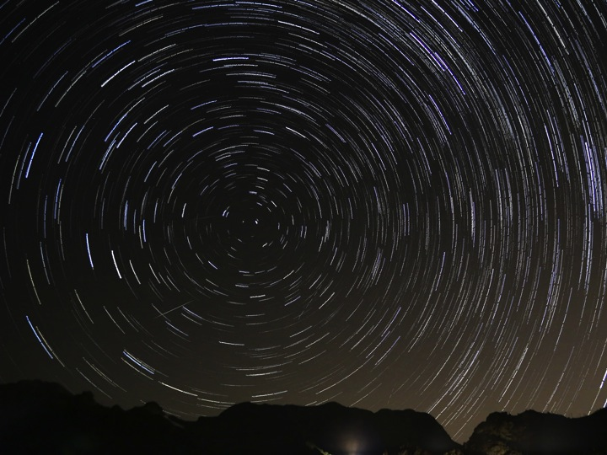
The apparent motion of the stars is consistent with
a rotating Sphere around a fixed Earth
OR
a rotating Earth inside fixed Celestial Sphere
Notes:
Point out the Celestial Equator and Poles as extensions of the Earth’s equator & poles

Slide 9
How does the sun move?

Slide 10
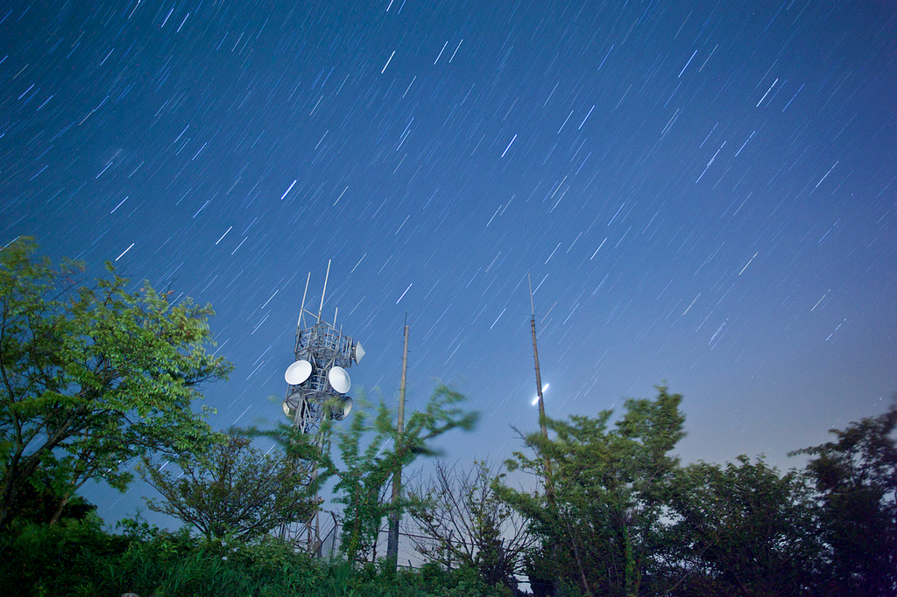
The stars move east to west, full circuit around the sky (Meridian to Meridian), each “sidereal or star day” (~ 23h 56m)
The Sun also moves east to west, full circuit around the sky (successive Meridian crossings), each “solar day” (24h 00m)

Slide 11
Relative to the stars, the Sun moves slowly eastward each day (~ 1 degree/day): full circuit around Celestial Sphere in one “year”
Path of Sun on the Celestial Sphere is called the “Ecliptic”
Constellations the Ecliptic passes through are referred to as the “zodiac”
day-to-day movement of Sun along Ecliptic

Slide 12
Objects other than the Sun and Moon moved through the sky independently of the background stars
asteres planetai
(ἀστέρες πλανῆται),
"wandering stars"

Slide 13
Planets Known in Ancient Times
“inferior planets”:
Mercury: difficult to see, always close to Sun in sky
Venus: very bright, always close to Sun in sky, but can be farther from Sun than Mercury
Mars: bright and noticeably red
Jupiter: very bright
Saturn: moderately bright
“superior planets”: (no restrictions relative to Sun)

Slide 14
The seven days of the week are named after the seven objects visible to the unaided eye in the sky that move independently of the stars.
Roman gods associated with planets
1. Saturn: Saturday
2. Sun: Sunday
3. Moon: Monday
Anglo-Saxon or Nordic analogues to Roman gods
4. Mars: Tuesday (Tiw’s day)
5. Mercury: Wednesday (Woden’s day)
6. Jupiter: Thursday (Thor’s day)
7. Venus: Friday (Frey’s day)

Slide 15
Motions of the planets
On short term (minutes, hours), planets appear to move with the stars, east to west, making a full circuit around the sky (meridian to meridian) in approximately one day
On the longer timescale (days, weeks, months), planets USUALLY move slowly eastward relative to the stars: different planets moving at different rates

Slide 16
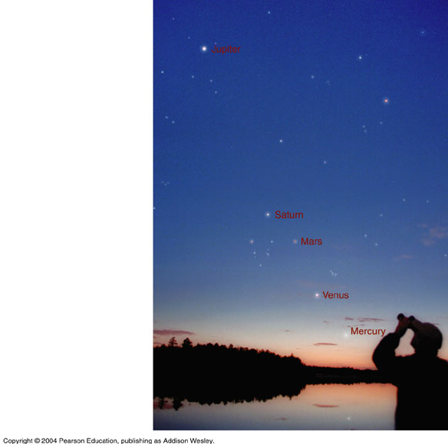
Planets are always seen close to the “Ecliptic”, the apparent annual path of the sun through the sky.

Slide 17
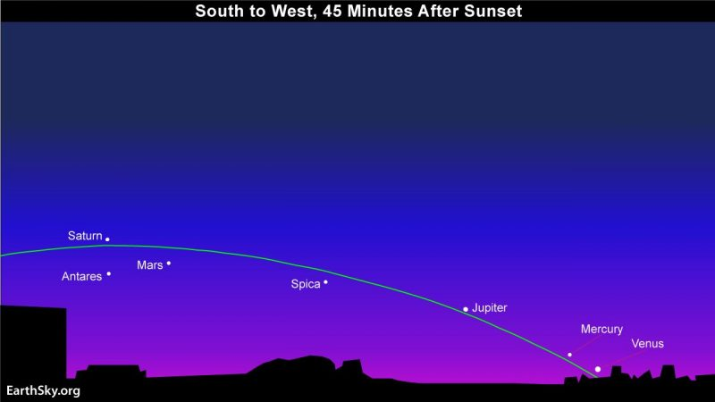
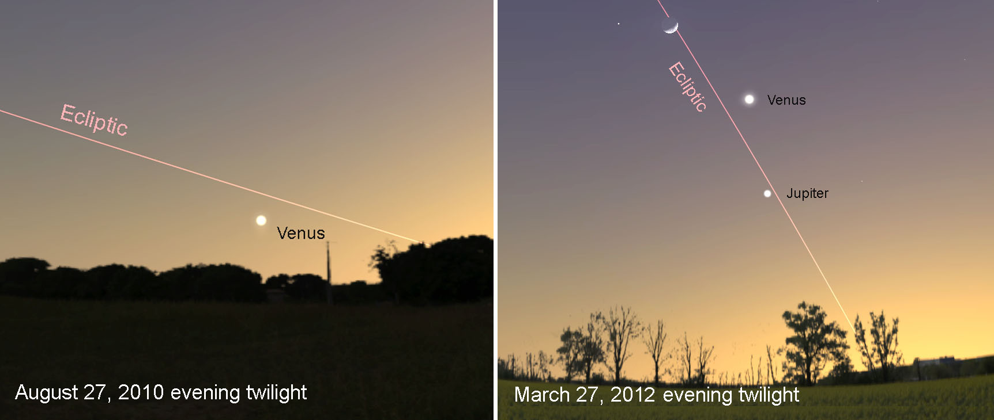
Early August 2016
Notes:
Sun always follows same path, the “Ecliptic”, around the Celestial Sphere
Planets are always found near the Ecliptic
The “inferior planets” are never far from the Sun in the sky
The “superior planets” are not limited in how close/far from the Sun they appear
Planets usually move slowly eastward relative to the stars: different planets moving at different rates

Slide 18
Planets occasionally reverse their motion relative to the stars, moving slowly westward relative to the stars, for a few days:
“apparent retrograde motion”
This effect is most pronounced with Mars.

Slide 19
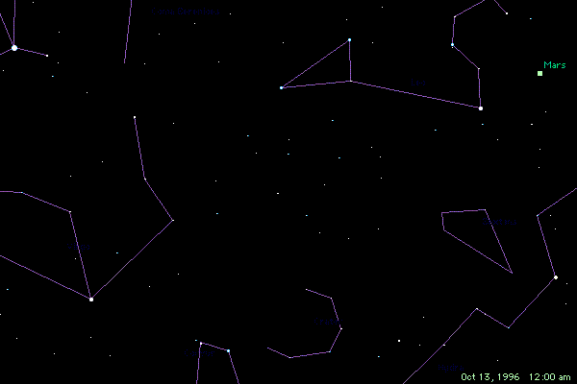
North
East
West
South

Slide 20

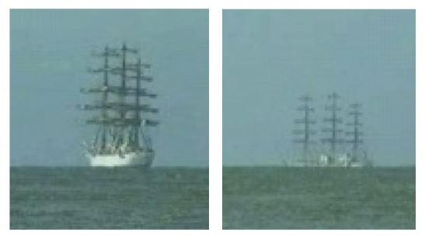
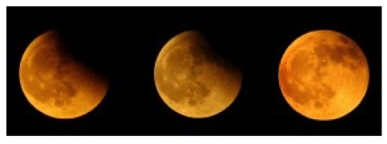
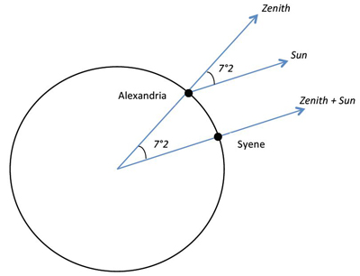
The Greeks were well aware that the Earth is a sphere.
Ships disappear over horizon at sea
Earth’s curved shadow on moon during eclipse
North Star appears higher in the sky as you travel north
They had an excellent idea of its true size.
Simultaneous Measurements of the Sun’s shadow at two locations on the Earth
But how did the Earth fit in with the rest of the Universe?

Slide 21
Observations were consistent with everything moving around a fixed Earth, i.e., a “Geocentric” universe

Slide 22
The basic tenets of the Greek geocentric universe were established by the time of Aristotle and Plato, ~ 4th Century BCE
Claudius Ptolemy (100-170 CE) refined and espoused a model (the Ptolemaic model) that lasted for nearly 15 centuries.
It did a reasonably good job explaining these motions (testing)

Slide 23
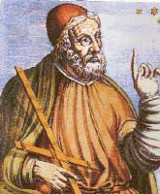
Claudius Ptolemy (100-170 CE)
Developed a “geocentric” model of the universe designed to fit the observational data.
Ptolemy and later scientists were strongly influenced by the belief of Plato that …
“all natural motion is circular”

Slide 24
Although the geocentric model of Ptolemy gained dominance, others actually proposed that the earth rotated daily and revolved around the sun (a “heliocentric” model)

Slide 25
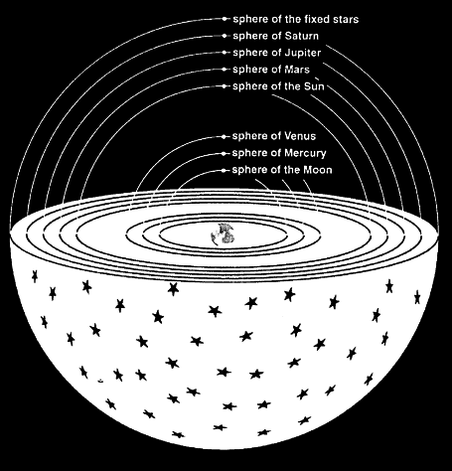
Ptolemy’s Geocentric Model
A set of nested spheres (“deferents”) centered on the nonrotating Earth & rotating at differing rates.
Objects in the sky are “fixed” to individual spheres, but not in a simple manner

Slide 26
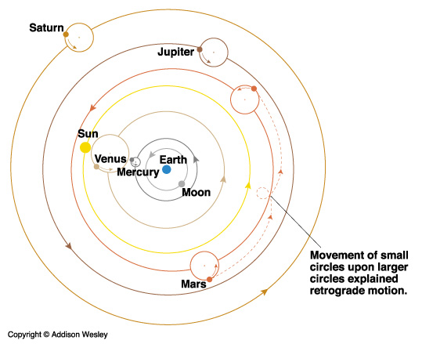
Ptolemy’s Geocentric Model
Sun “orbits” Earth – reflecting the rotation of its sphere
Planets orbit on small circles (epicycles) whose centers are on spheres (deferents) that are rotating about the Earth (this explains retrograde motion)

Slide 27
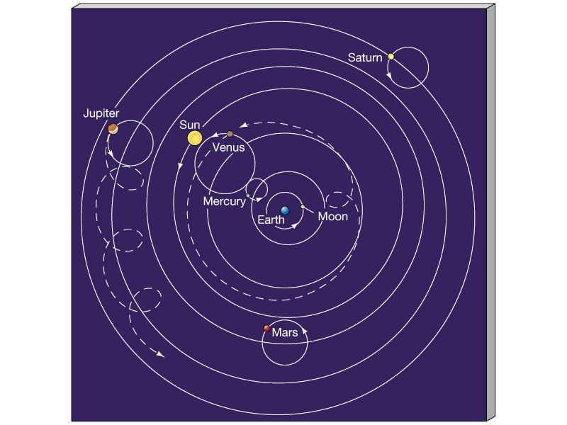
Planets
moved on epicycles
whose centers were located on deferents
that rotated around the earth
This produced complex motions

Slide 28
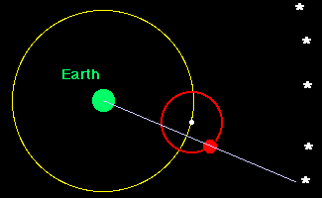
Apparent retrograde motion was explained in Ptolemy’s geocentric model

Slide 29
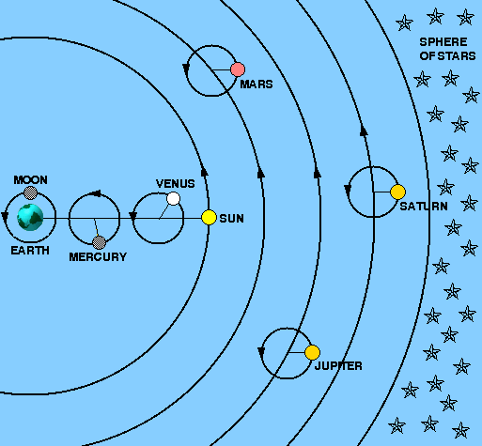
Geocentric Model
Planet “orbits” lie in approximately the same plane (this explains why the planets are always near the ecliptic)
Inferior planet epicycles were fixed to the Earth-Sun line (this explained why Mercury & Venus never stray far from the Sun).

Slide 30
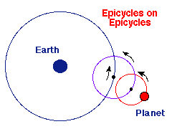
Ptolemy’s Geocentric Model
Relied upon circles upon circles (epicycles & deferents) to explain the motions of planets and the sun.
Tied to Plato & Aristotle’s belief that “all natural motion is circular”
In order to make accurate predictions, the basic model required modifications, such as deferents that are not centered on the Earth and the additions of epicycles upon epicycles

Slide 31
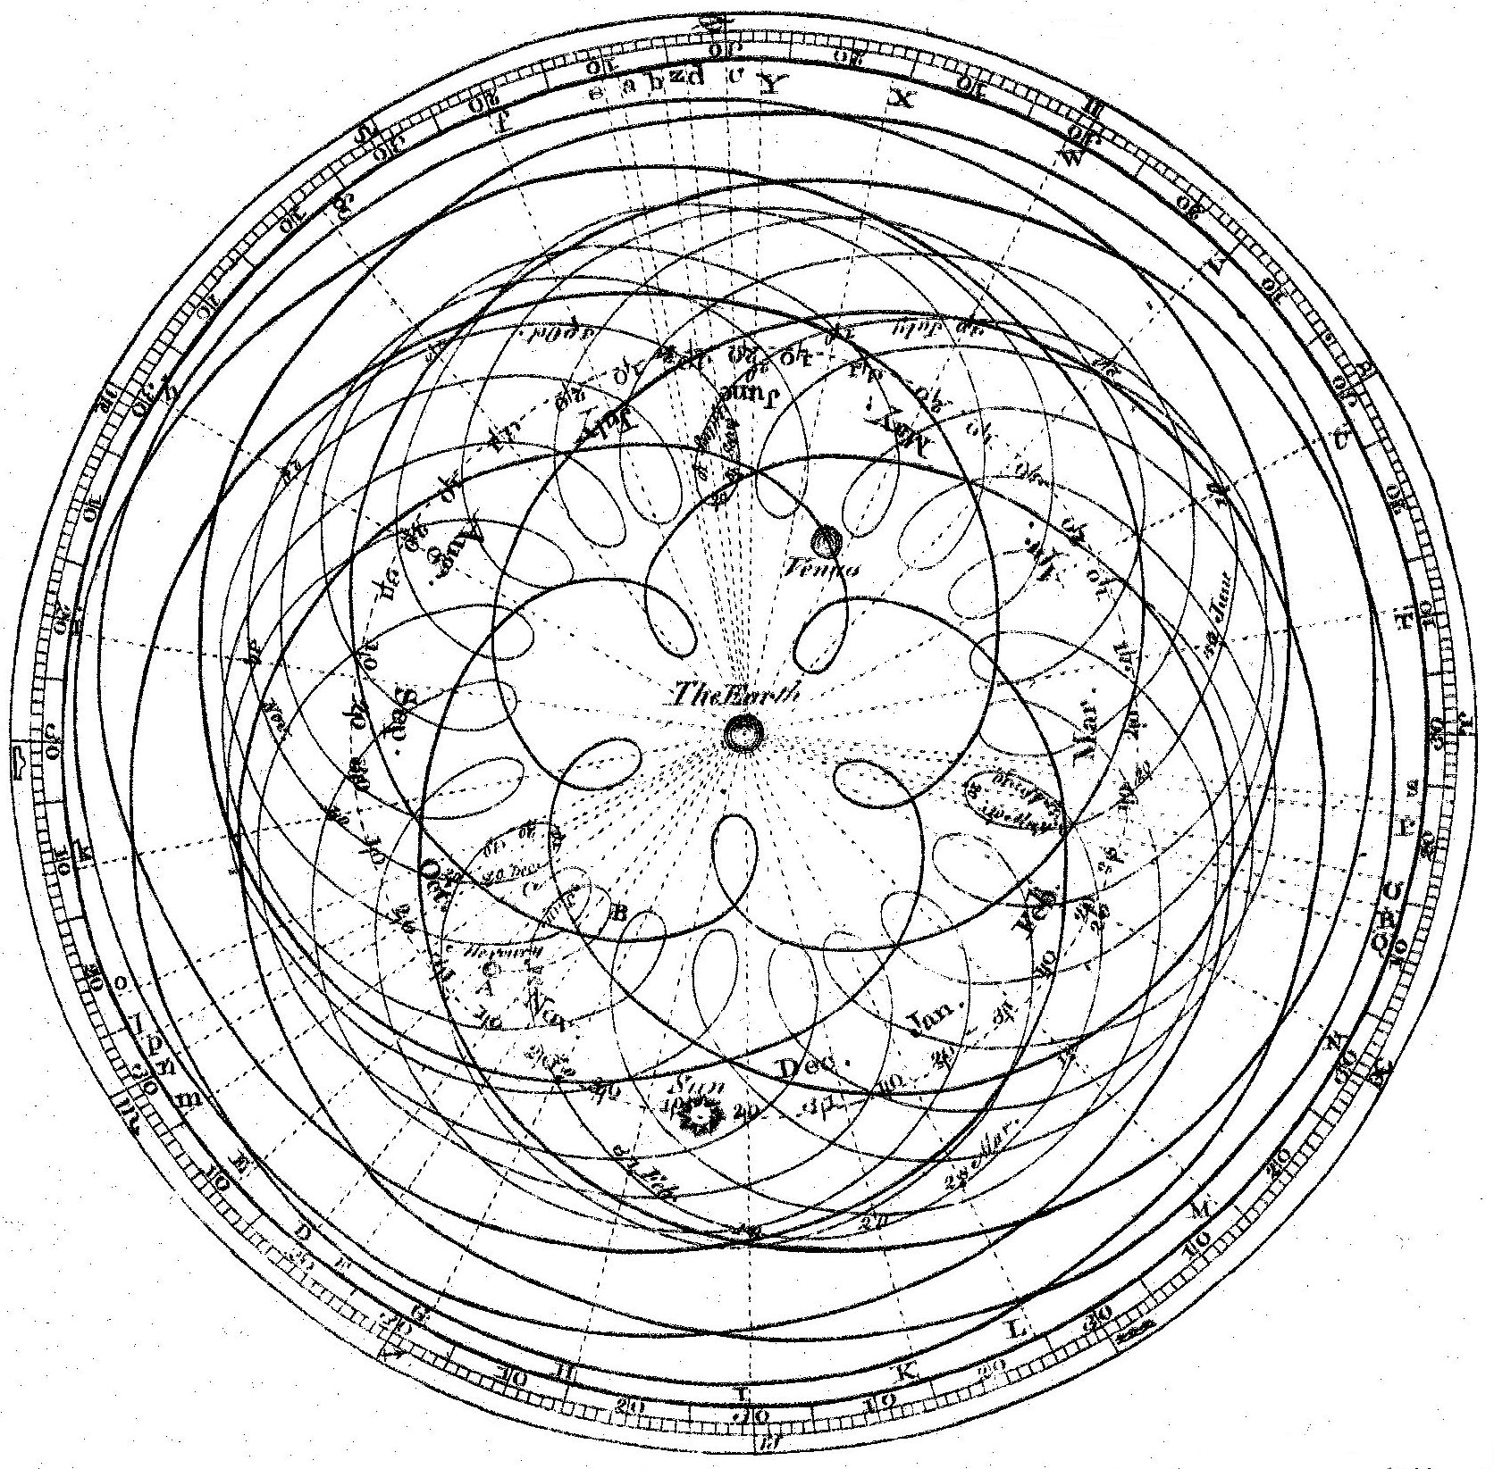
Problem: In order to track the observed motions of the planets with reasonable accuracy, Ptolemy and others had to introduce many complications to the simple epicyclic picture:
This violated the aesthetic sensibilities of everybody (including Ptolemy himself).

Slide 32
Ptolemy’s model,
with modifications,
fit the data (Observations)
&
made fairly accurate predictions,
but was horribly contrived!

Slide 33
“If I had been present at the creation, I would have recommended a simpler design for the universe”.
- Spanish monarch Alphonso X
(13th century)

Slide 34
Despite its complexity, Ptolemy’s geocentric model was the standard for almost 1500 years

Slide 35
Plato proposed that the orbits of the planets have what shape?
conical
circular
elliptical
equal-angular
epicycles

Slide 36
Plato proposed that the orbits of the planets have what shape?
conical
circular
elliptical
equal-angular
epicycles

Slide 37
The diurnal (daily) motion of stars in the Ptolemaic model is due to
the motion of the earth around the sun
the rotation of the earth
the epicyclic nature of the celestial sphere
the rotation of the celestial sphere to which the stars are attached

Slide 38
The diurnal (daily) motion of stars in the Ptolemaic model is due to
the motion of the earth around the sun
the rotation of the earth
the epicyclic nature of the celestial sphere
the rotation of the celestial sphere to which the stars are attached

Slide 39
What is the ecliptic?
when the Moon passes in front of the Sun
the constellations commonly used in astrology to predict the future
the Sun's daily path across the sky
the Sun's apparent annual path around the celestial sphere

Slide 40
What is the ecliptic?
when the Moon passes in front of the Sun
the constellations commonly used in astrology to predict the future
the Sun's daily path across the sky
the Sun's apparent annual path around the celestial sphere

Slide 41
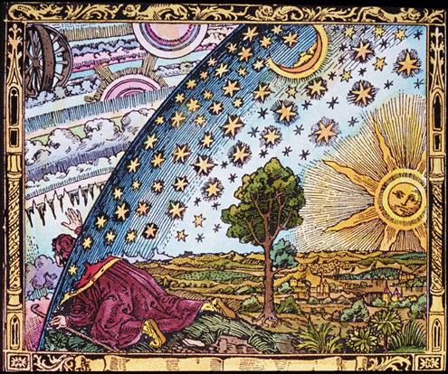
The Revolution Begins!

